Slide 1
Keys and other connecting elements

Slide 2
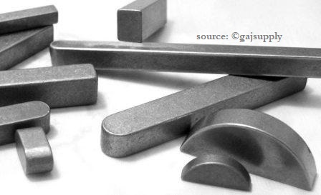
Keys and Couplings

Slide 3
Think about it!...
How are the gears attached to the shafts?
How is the input shaft connected to the motor or engine that delivers the power?
How is the output shaft connected to the driven machine?
How are the gears located axially along the shafts?
How can you keep contaminants from the outside from getting inside?
How can you keep lubricating oil inside?

Slide 4
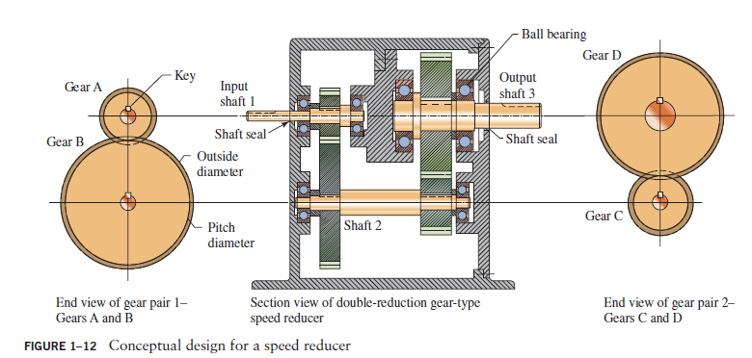

Slide 5
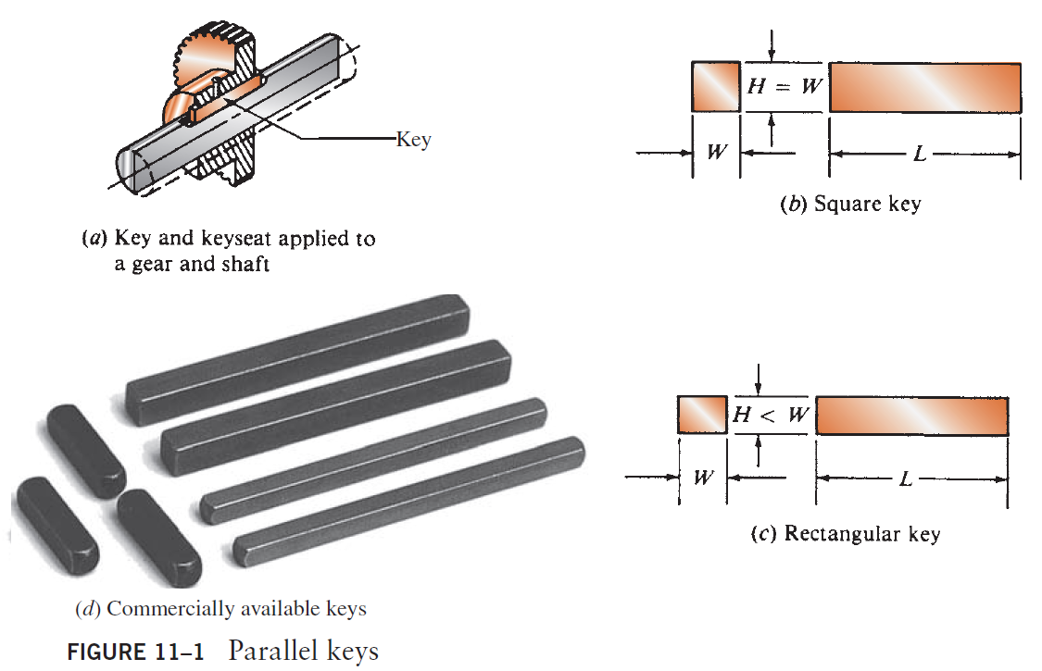
Keys
A key is used to connect a drive member such as a belt pulley, chain sprocket, or gear to the shaft that carries it.

Slide 6
Keyseat
A similar groove in the hub of the power-transmitting element is usually called a keyway, but it is more properly also a keyseat.

Slide 7
Square and Rectangular Parallel Keys
The most common type of key for shafts up to 6.5 in in diameter is the square key.
The rectangular key is recommended for larger shafts and is used for smaller shafts where the shorter height can be tolerated.
Both the square and the rectangular keys are referred to as parallel keys because the top and bottom and the sides of the key are parallel

Slide 8
Key sizes
Table 11–1 gives the preferred dimensions for parallel keys as a function of shaft diameter for both U.S. sizes and SI Metric sizes.
The width is approximately one-quarter of the diameter of the shaft.
Exactly one-half of the height of the key is bearing on the side of the shaft keyseat and the other half on the side of the hub keyseat.
The distance Y is the radial distance from the theoretical top of the shaft, before the keyseat is machined, to the top edge of the finished keyseat to produce a keyseat depth of exactly H/2.

Slide 9
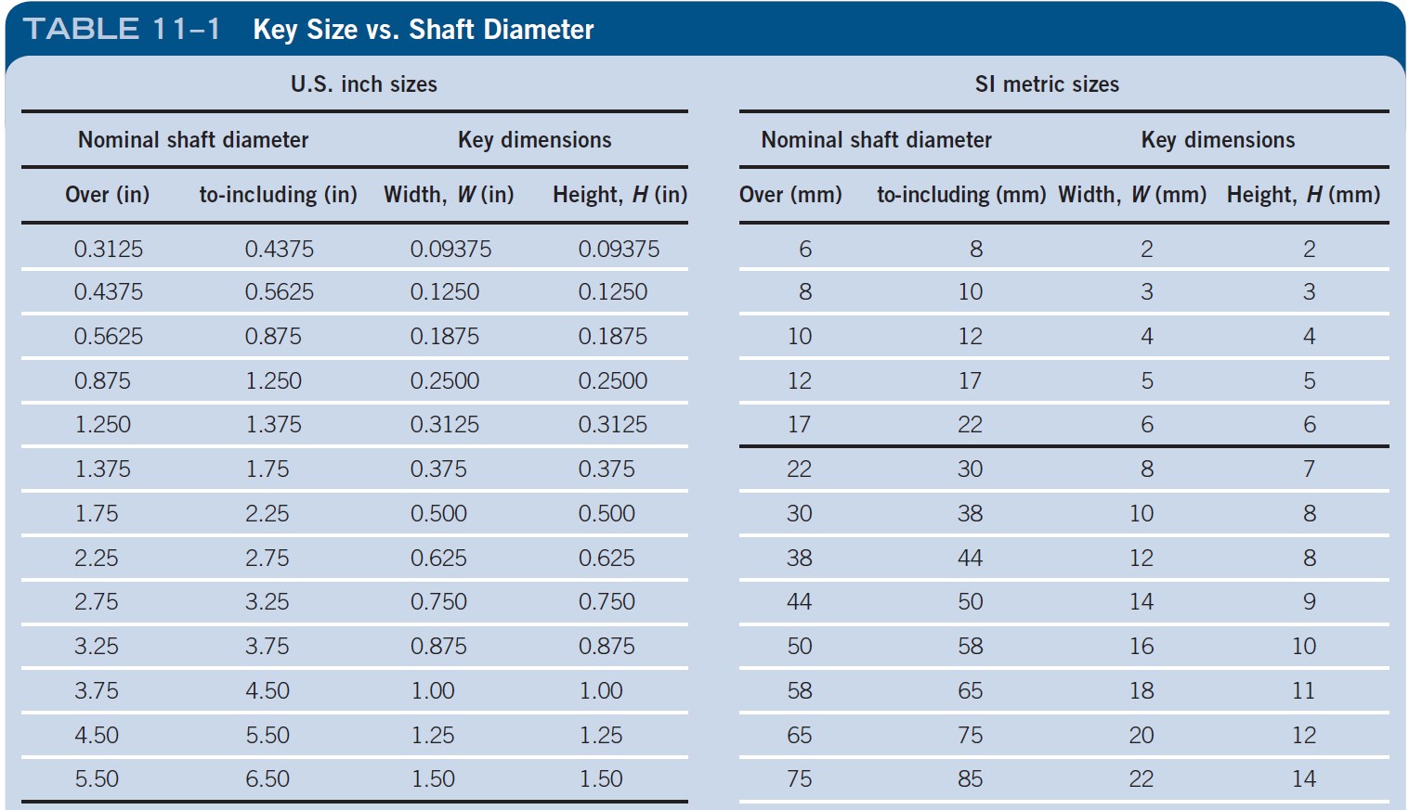
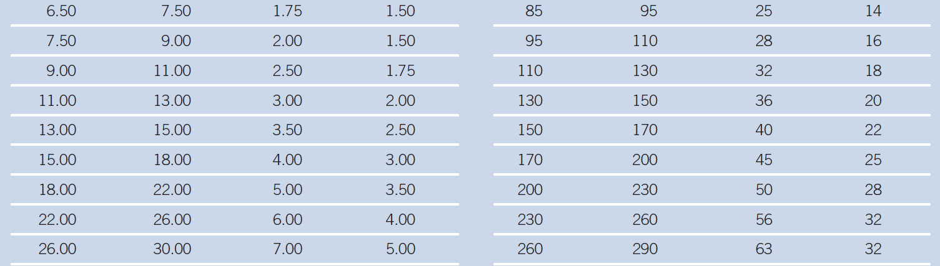

Slide 10
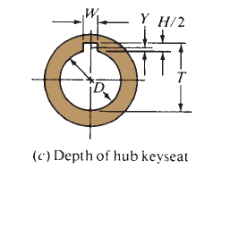
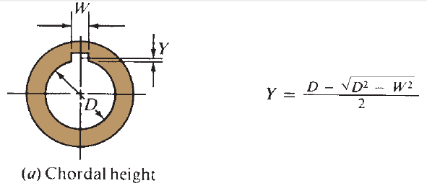
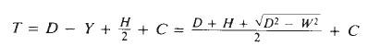
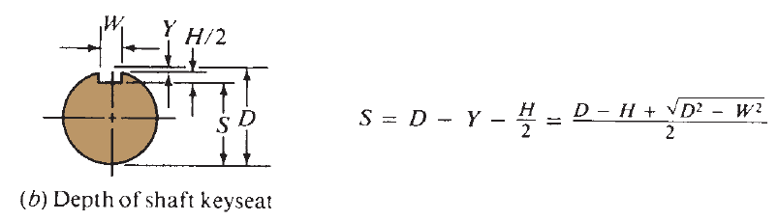
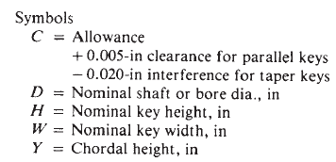
Dimensions of parallel Keys
To assist in machining and inspecting the shaft or the hub, the dimensions S and T can be computed and shown on the part drawings.

Slide 11
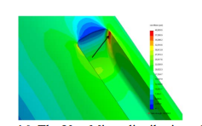
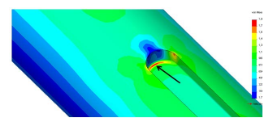
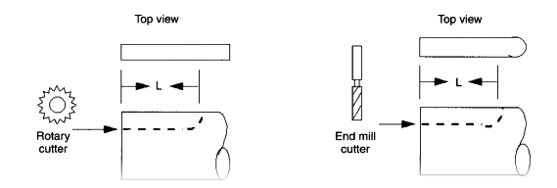
Key seat

Slide 12
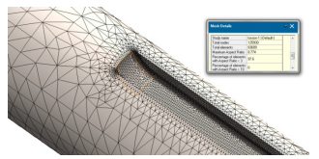
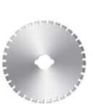
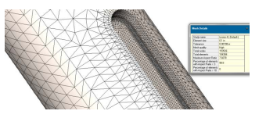
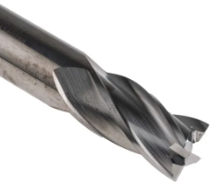
Sled Runner
Profile

Slide 13
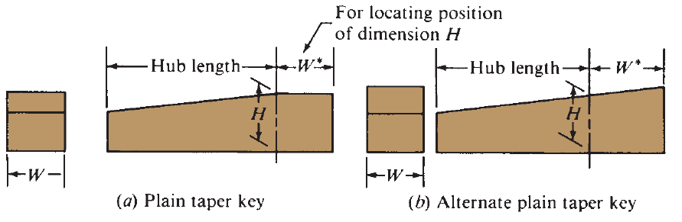
Taper Keys
Taper are designed to be inserted from the end of the shaft after the hub is in position rather than installing the key first and then sliding the hub over the key as with parallel keys.
The taper extends over at least the length of the hub, and the height, H, measured at the end of the hub, is the same as for the parallel key

Slide 14
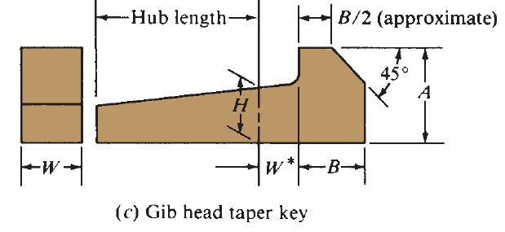
Gib Head Keys
The gib head key has a tapered geometry inside the hub that is the same as that of the plain taper key. But the extended head provides the means of extracting the key from the same end at which it was installed.

Slide 15
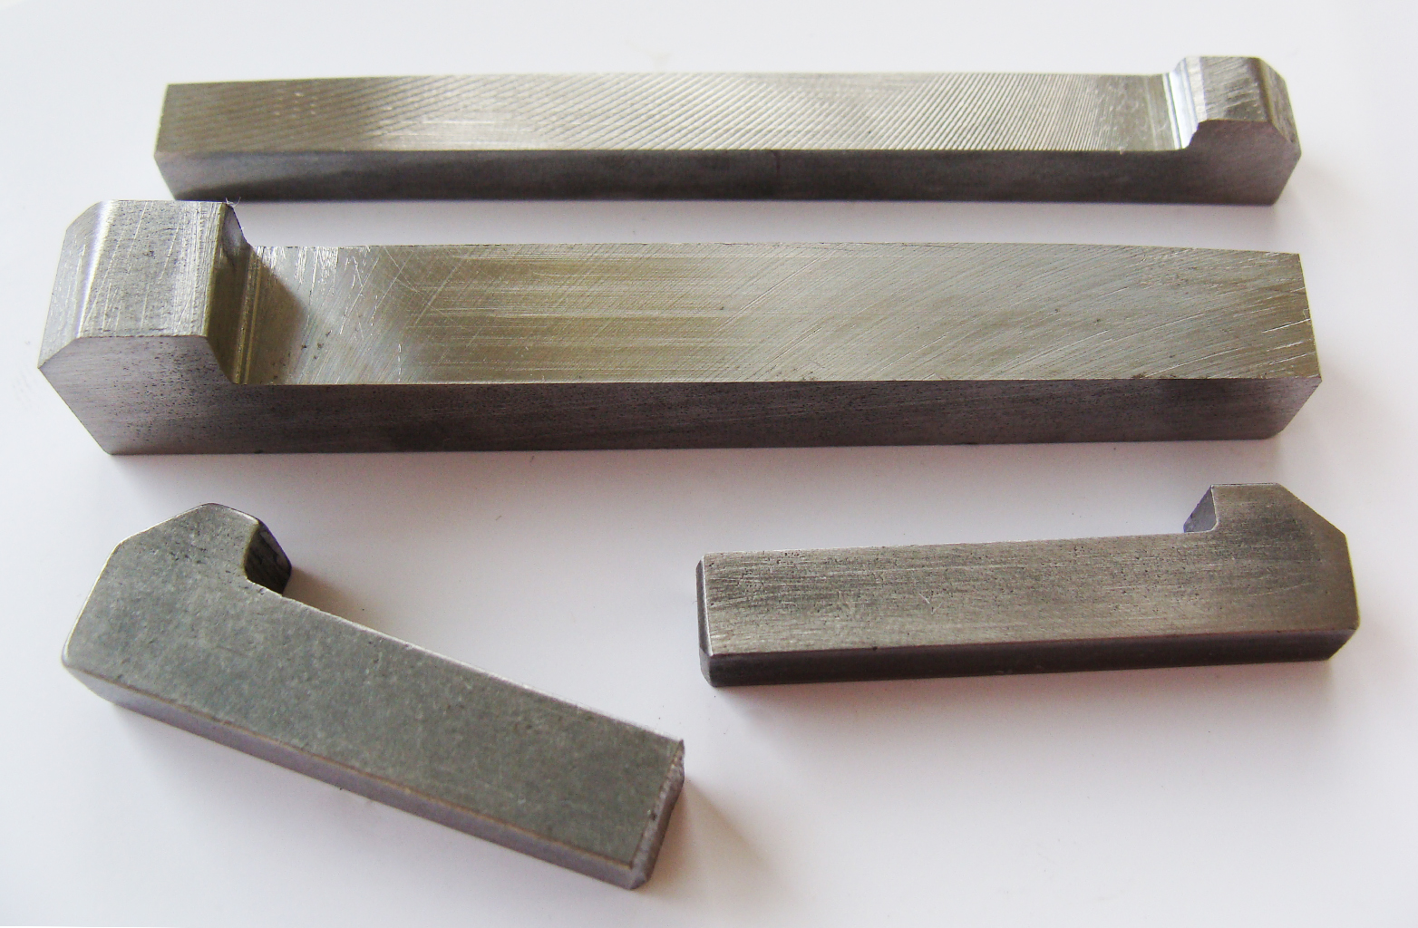
Gib Head Keys

Slide 16
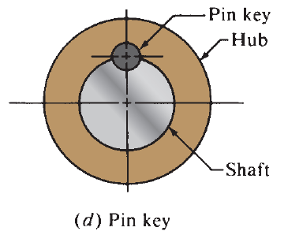
Pin Keys
The pin key, shown in is a cylindrical pin placed in a cylindrical groove in the shaft and hub.
Lower stress concentration factors result from this design as compared with parallel or taper keys.
A close fit between the pin and the groove is desired. So that the pin does not move and the bearing is uniform along the length of the pin.

Slide 17
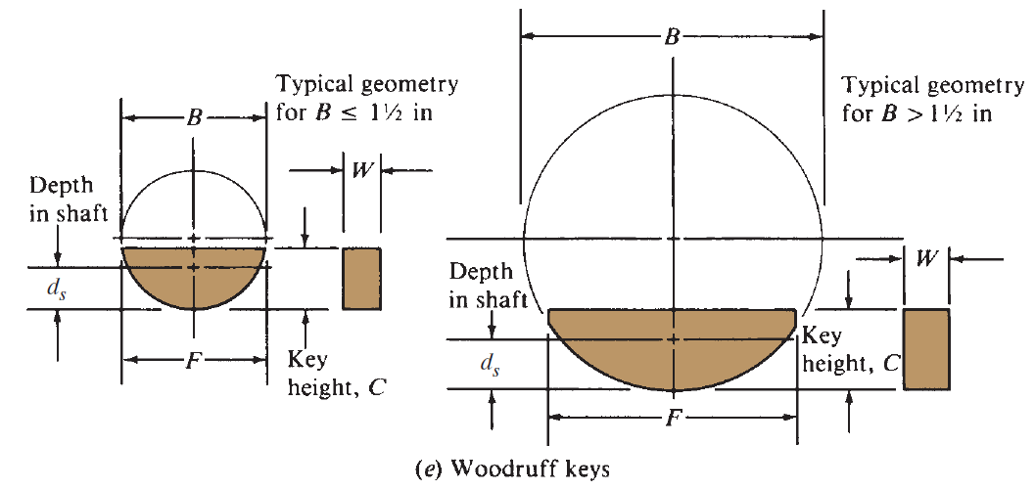
Woodruff Keys
Where light loading and relatively easy assembly and disassembly are desired, the Woodruff key should be considered.

Slide 18
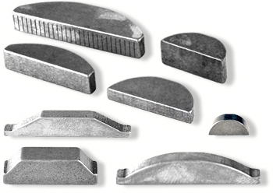
Woodruff Keys

Slide 19
Woodruff Keys
The circular groove in the shaft holds the key in position while the mating part is slid over the key.
ANSI Standard B17.2–1967 lists the dimensions for a large number of standard Woodruff keys and their mating keyseats.
Table 11–3 provides a sampling of those sizes.
Note that the key number indicates the nominal key dimensions. The last two digits give the nominal diameter, B, in eighths of an inch, and the digits preceding the last two give the nominal width, W, in thirty-seconds of an inch.

Slide 20
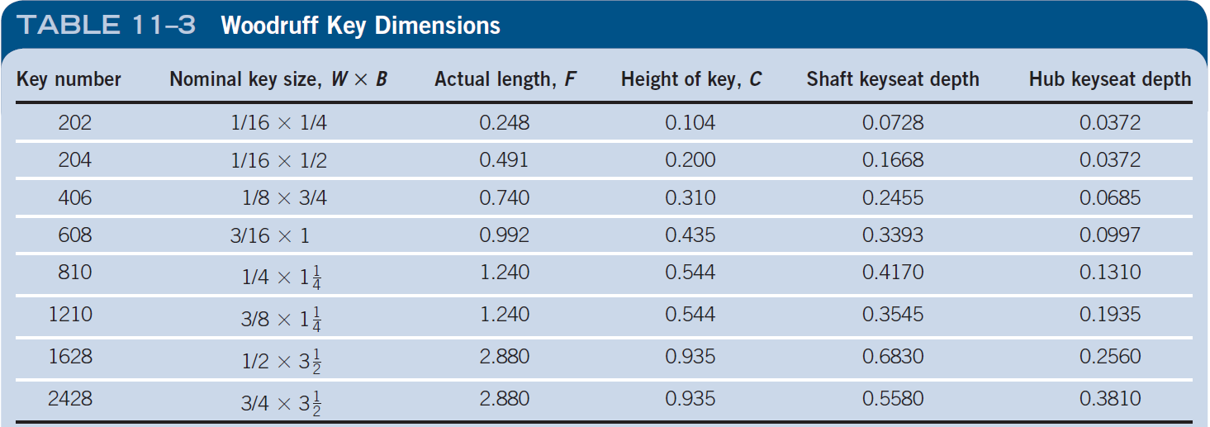
Woodruff Keys Dimensions
Note that the key number indicates the nominal key dimensions. The last two digits give the nominal diameter, B, in eighths of an inch, and the digits preceding the last two give the nominal width, W, in thirty-seconds of an inch.

Slide 21
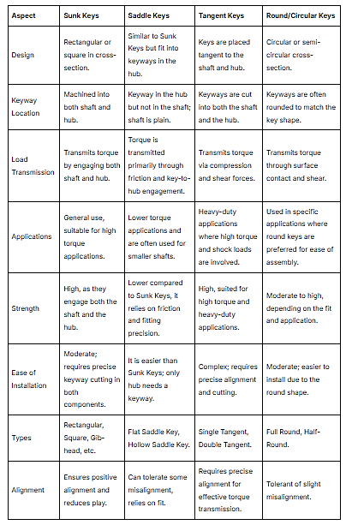

Slide 22


Slide 23


Slide 24
Material for Keys

Slide 25
Material for Keys
Keys are made from plain carbon steel, alloy steels, stainless steels, and some nonferrous metals.
Even plastics are used for small devices under low loads.

Slide 26
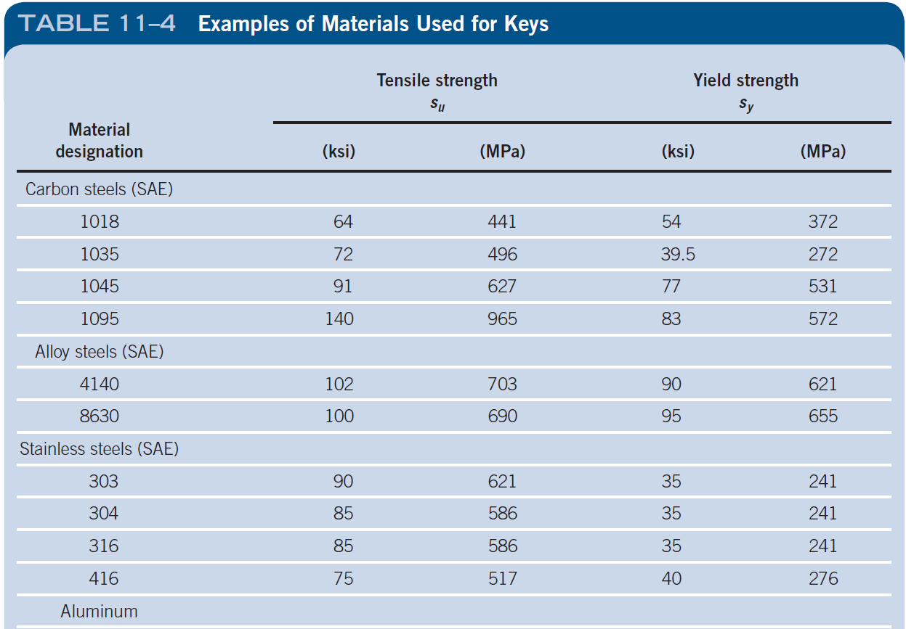

Slide 27
Stress Analysis to determine Key Length
There are two basic modes of potential failure for keys transmitting power:
(1) shear across the shaft/ hub interface and
(2) compression failure due to the bearing action between the sides of the key and the shaft or hub material.
The analysis for either failure mode requires an understanding of the forces that act on the key.

Slide 28
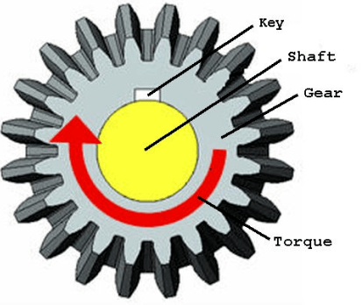

Slide 29
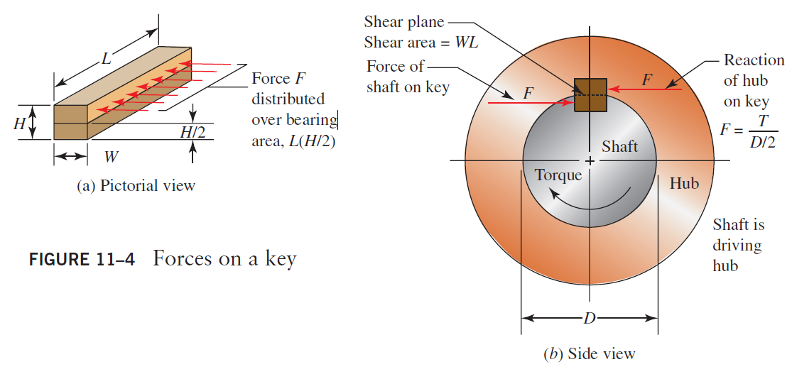
Forces on a Key

Slide 30
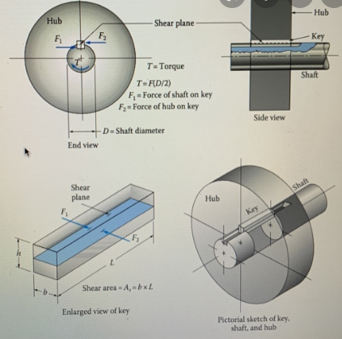

Slide 31
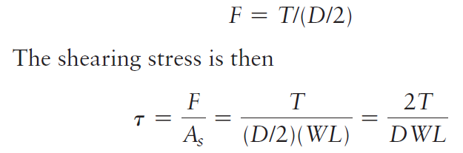
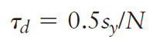
Forces on a Key
The magnitude of the shearing force can be found from:
In design, we can set the shearing stress equal to a design stress in shear for the maximum shear stress theory of failure:

Slide 32
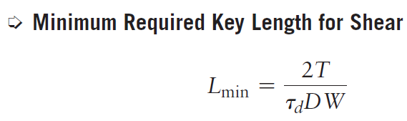
Minimum length for shear

Slide 33
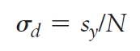
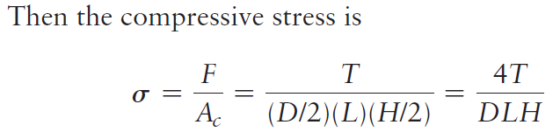
Bearing failure in keys
The failure in bearing is related to the compressive stress on the side of the key, the side of the shaft keyseat, or the side of the hub keyseat.
Let’s define a design stress for compression as

Slide 34
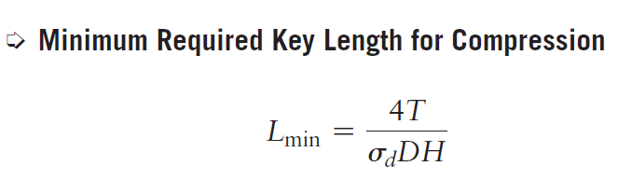
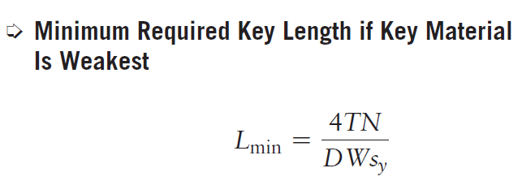
Minimum Required Length
For the design of a square key in which the strength of the key material is lower than that of the shaft or the hub.

Slide 35
DESIGN PROCEDURE FOR PARALLEL KEYS
Complete the design of the shaft into which the key will be installed and specify the actual diameter at the location of the keyseat.
Select the size of the key from Table 11–1.
Specify a suitable design factor, N. In typical industrial applications, N = 3 is adequate to accommodate accidental overloads and shock.
Specify the material for the key, usually SAE 1018 steel. A higher-strength material can be used.

Slide 36
DESIGN PROCEDURE FOR PARALLEL KEYS
Determine the yield strength of the materials for the key, the shaft, and the hub.
If a square key is used and the key material has the lowest strength, compute the minimum required length of the key. This length will be satisfactory for both shear and bearing stress.
If a rectangular key is used, or if either the shaft or the hub has a lower strength than the key, compute the minimum required length of the key based on bearing stress. Also compute the minimum required length based on shear of the key. The larger of the two computed lengths governs the design.
Check to be sure that the computed length is shorter than the hub length. If not, a higher-strength material must be selected and the design process must be repeated. Alternatively, two keys or a spline can be used instead of a single key.

Slide 37
DESIGN PROCEDURE FOR PARALLEL KEYS
Specify the actual length of the key to be equal to or longer than the computed minimum length. A convenient standard size should be specified using the preferred basic sizes shown in Appendix A2–1.
The key should extend over all or a substantial part of the length of the hub. But the keyseat should not run into other stress raisers such as shoulders or grooves.
Complete the design of the keyseat in the shaft and the keyway in the hub
See also Chapter 15 for additional details concerning tolerancing and chamfering.

Slide 38
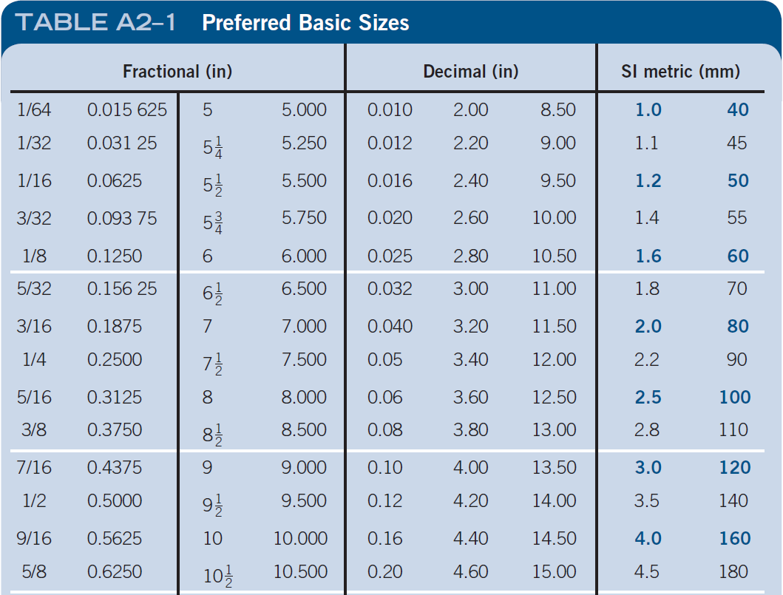
Appendix 2- Table A2-1 – Preferred Basic Sizes

Slide 39
Example Problem
A portion of a shaft where a gear is to be mounted has a diameter of 2.00 in. The gear transmits 2965 lb.in of torque. The shaft is to be made of SAE 1040 cold-drawn steel.
The gear is made from SAE 8650 OQT 1000 steel. The width of the hub of the gear mounted at this location is 1.75 in. Design the key.

Slide 40
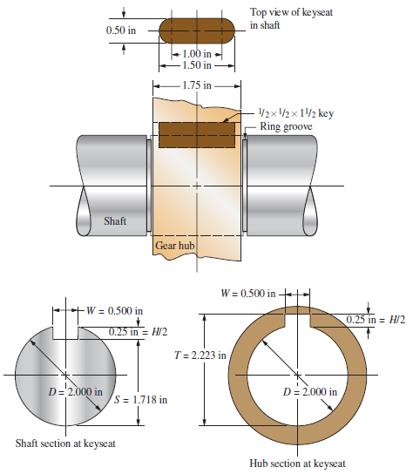
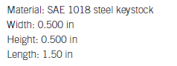
Example Problem

